Slide 1

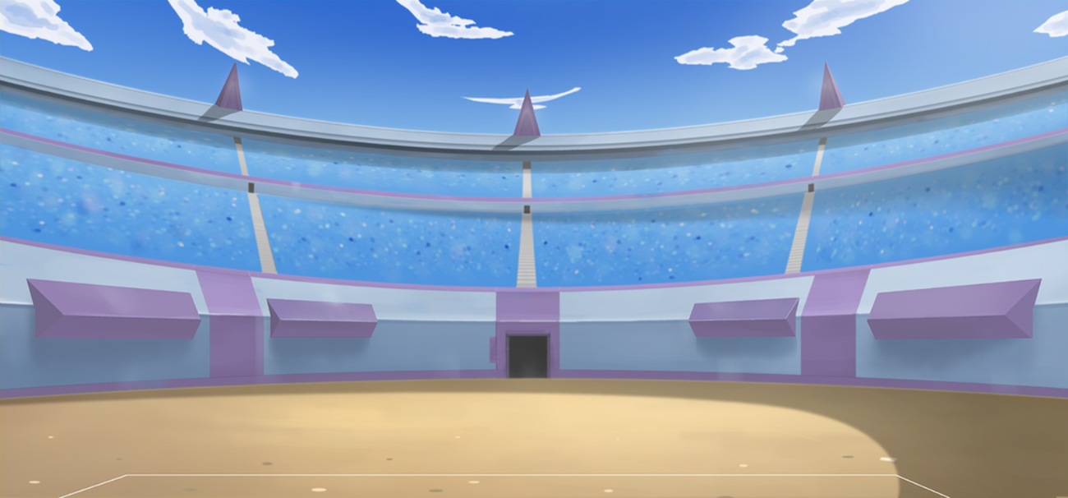

By: Muhab Ehab

Slide 2
"Do you want to try one of the first and best Pokémon video games and don't know who to pick for your team? Just keep up with me, and I'm going to tell you who to choose."

Slide 3
Let’s get to know our data first

Slide 4
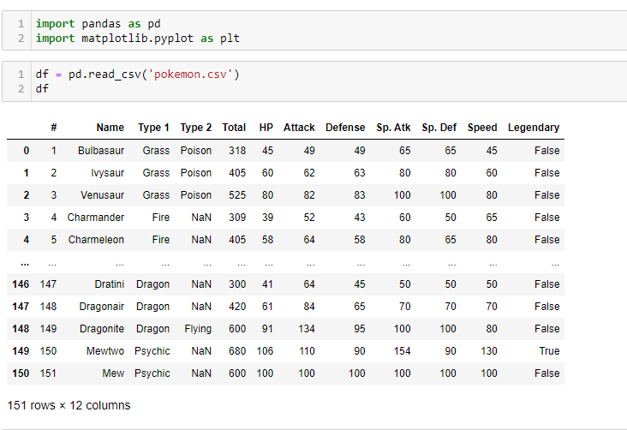


Slide 5
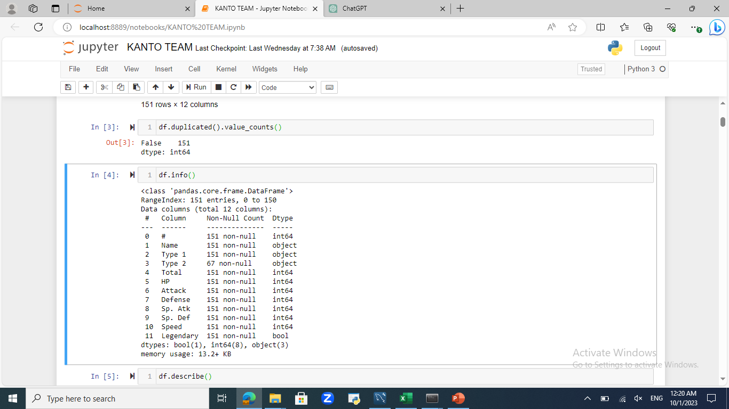
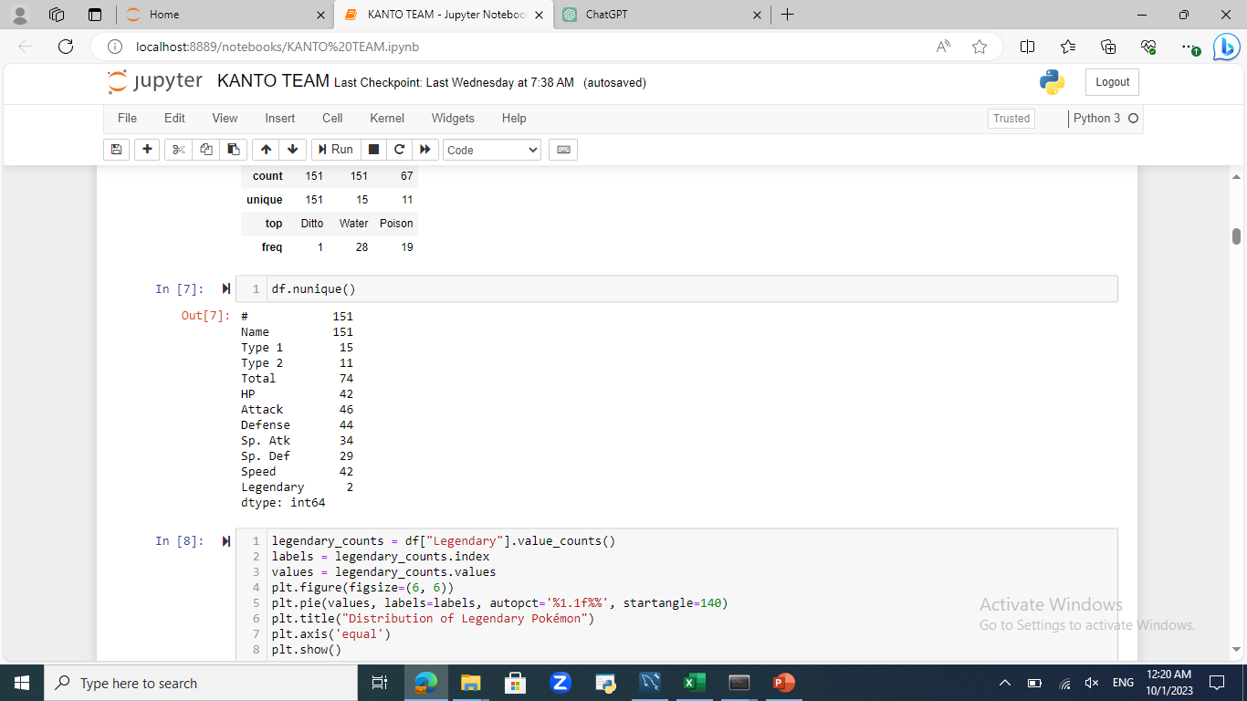


Slide 6
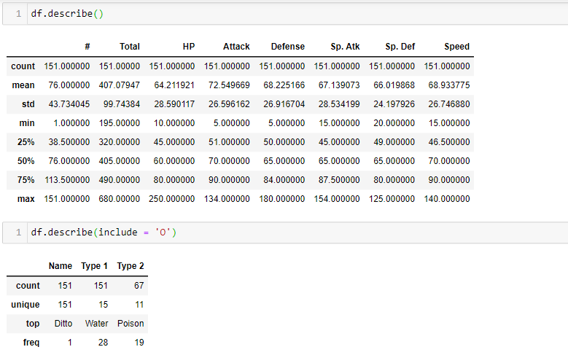


Slide 7
Now let’s check the legendary Pokémons and remove them

Slide 8
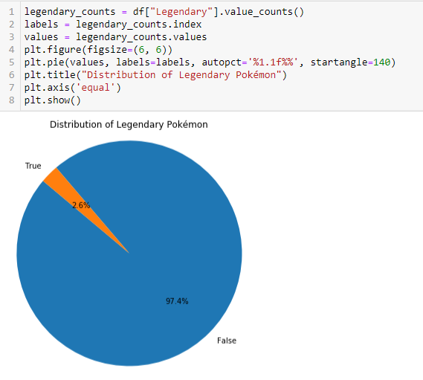

That chart shows the difference between legendary Pokémon and the non-legendary ones.

Slide 9

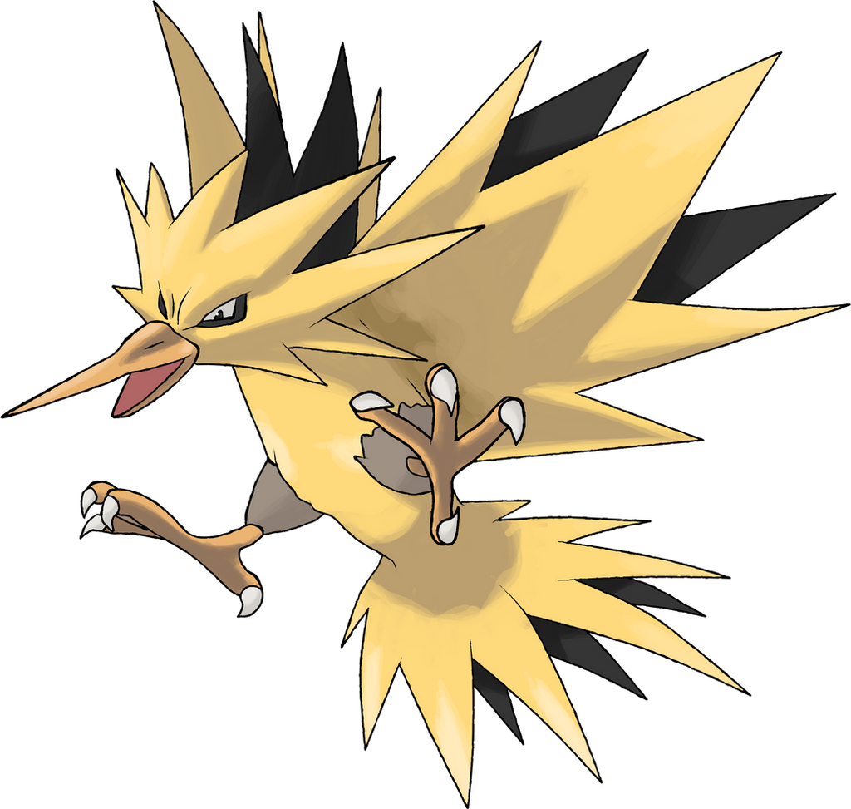
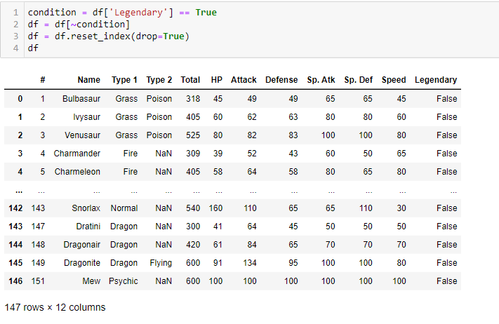
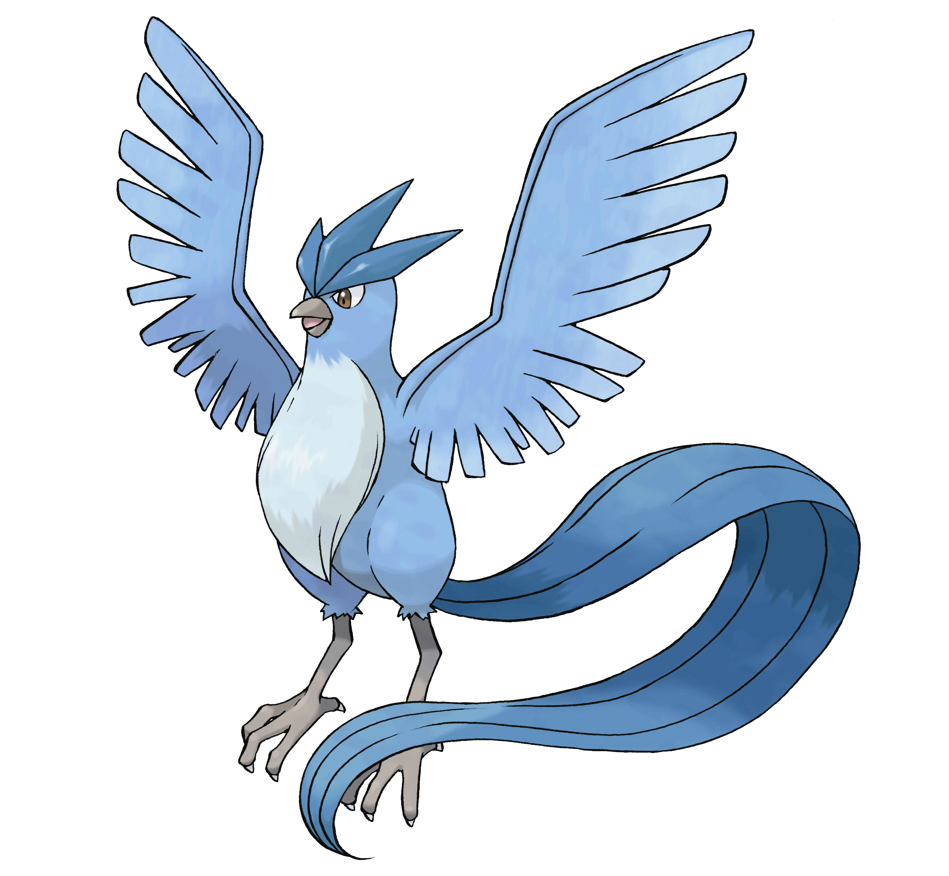

Slide 10
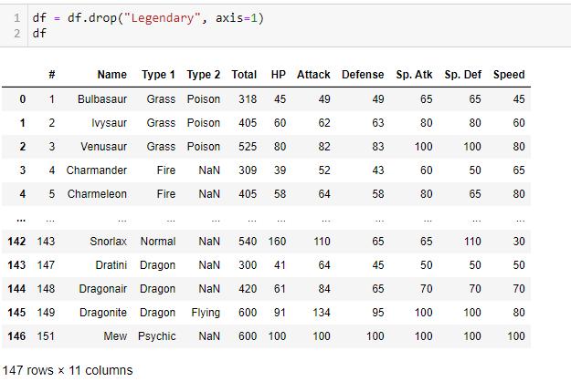

Now we’ll drop the “Legendary” column because we don’t need it anymore

Slide 11
Now let’s say goodbye to “Mew”

Slide 12
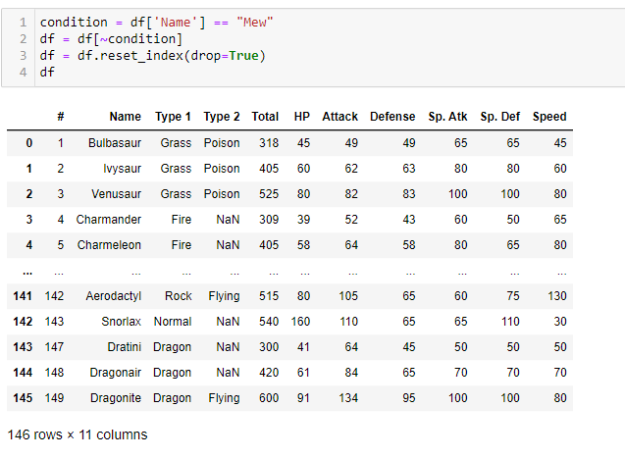


Slide 13
Now we show & eliminate the weak ones

Slide 14
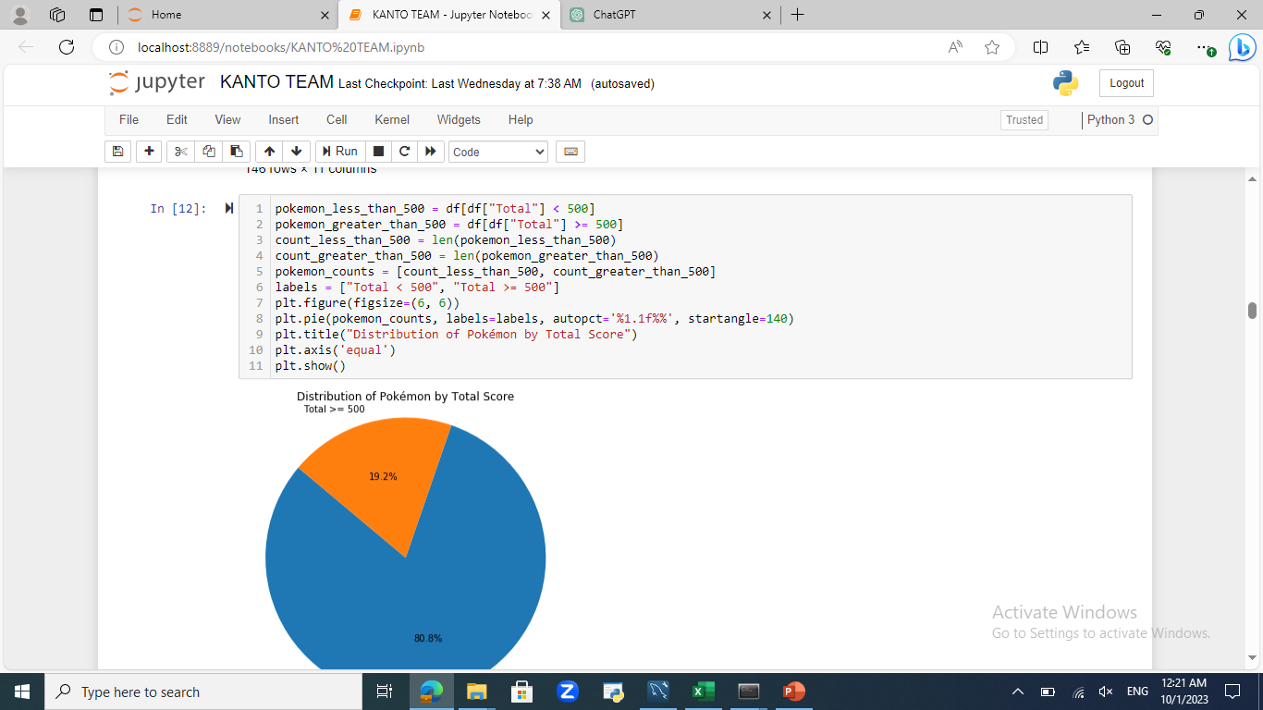



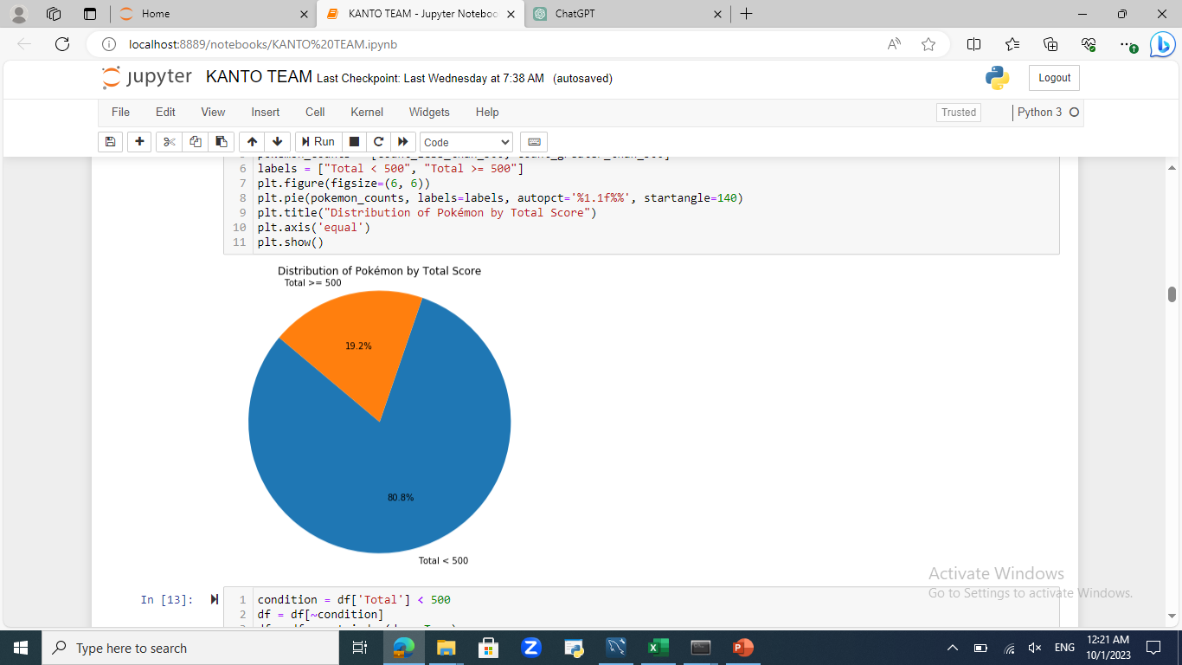


Slide 15
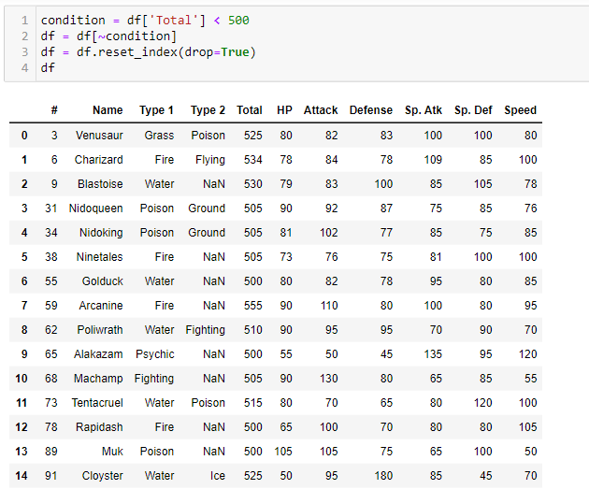


Slide 16
Now let’s start by adding the strongest guys to the team

Slide 17
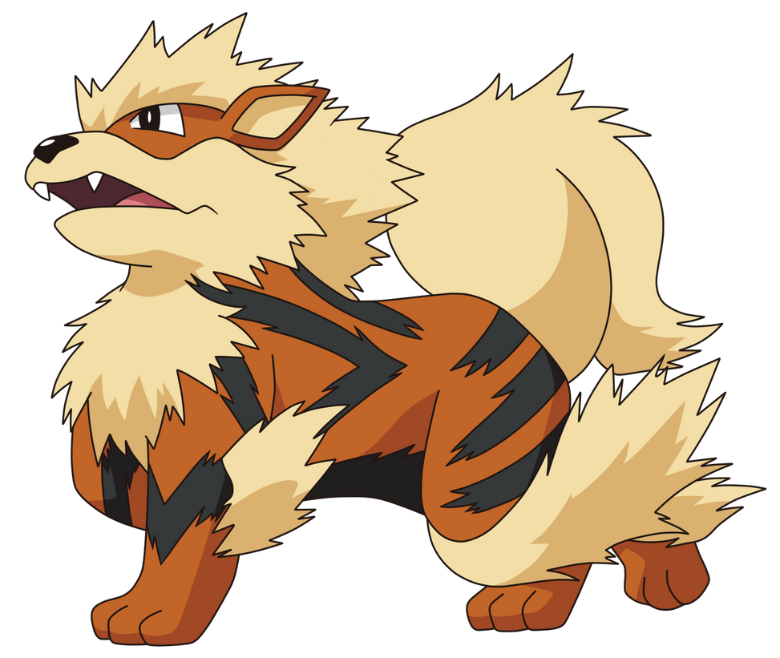
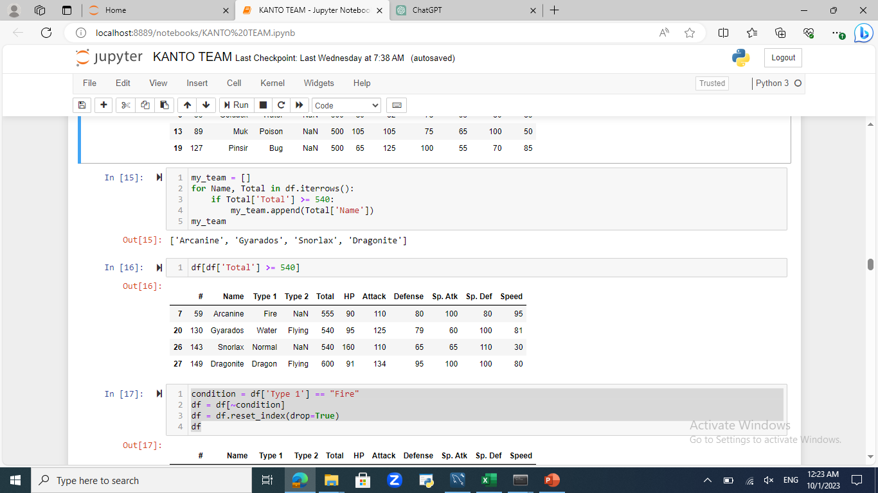
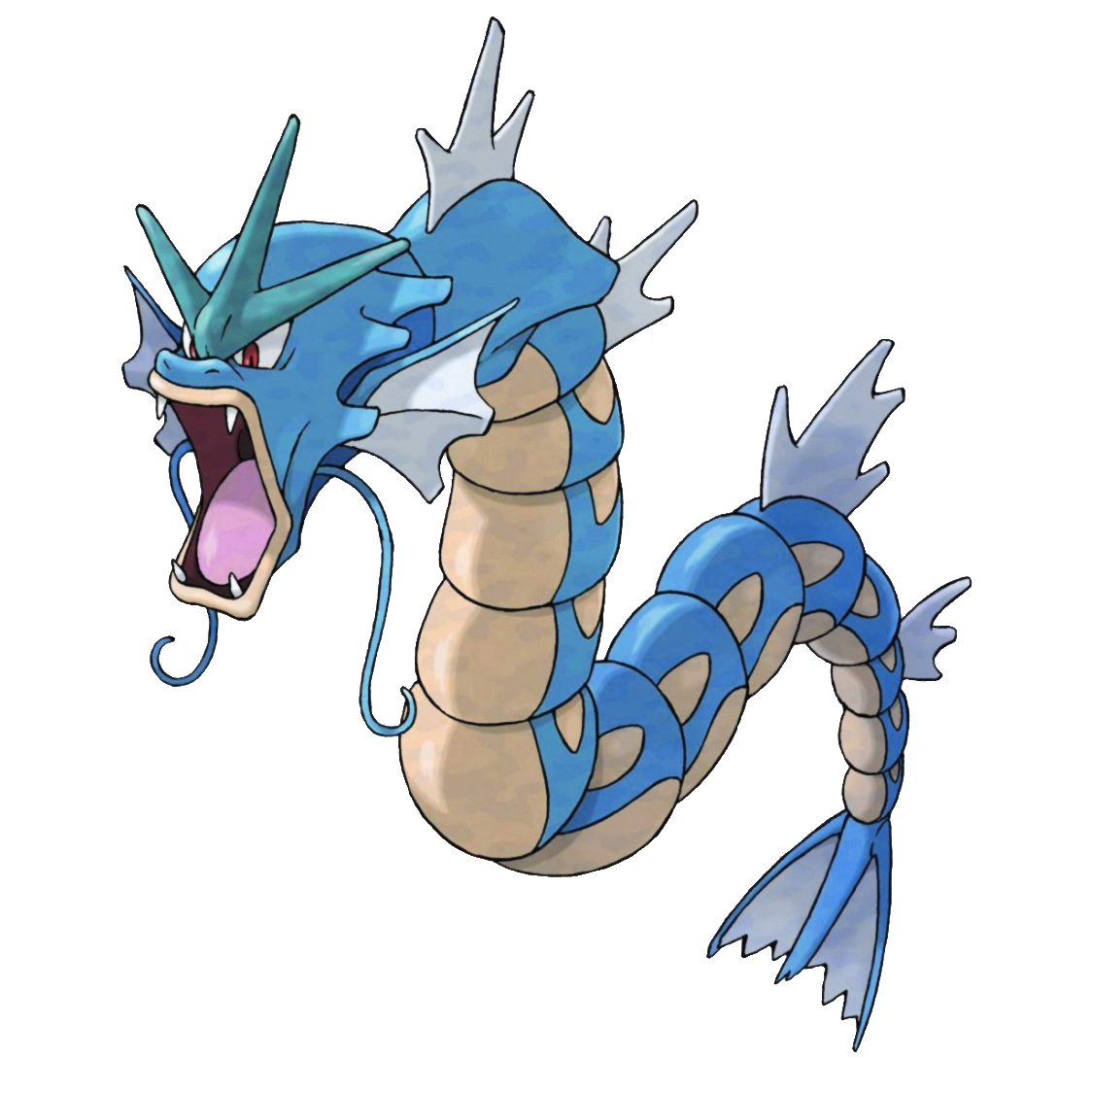



Slide 18


How to get Arcanine in the game
You gotta obtain Growlithe first, the pre-evolved form of Arcanine. You can find Growlithe in the wild on Route 8, which is between Lavender Town and Celadon City.
You can evolve Growlithe by using the fire stone into Arcanine but keep in mind that once you evolve Growlithe into Arcanine, it will not learn any new moves by leveling up.
So, make sure to train it with the moves you want it to have before evolving it into Arcanine.

Slide 19

How to get Gyarados in the game
Gyarados evolves from Magikarp, which is known for being one of the weakest and most common Pokémon in the game.
You can usually find Magikarp by fishing with an Old Rod in any location.
After reaching level 20, your Magikarp will evolve into Gyarados automatically which is known for its powerful stats and moves.
This evolution can be a significant upgrade for your team. It's worth the effort to train a Magikarp into a Gyarados in Pokémon FireRed.

Slide 20
How to get Snorlax in the game
Obtain the Poké Flute, you need the Poké Flute to wake up Snorlax.
You can get the Poké Flute from Mr. Fuji in the Pokémon Tower in Lavender Town.
Once you have the Poké Flute, return to Route 12 or Route 16, and you'll find a sleeping Snorlax blocking the path, you will play the Poké Flute, waking it up, to battle with that Snorlax.
Snorlax has high HP and defense stats, making it a sturdy addition to your team, Snorlax has strong moves and a high catch rate, make sure you have a supply of Ultra Balls or other high-quality Poké Balls to capture it.
.

Slide 21


How to get Dragonite in the game
At the Safari Zone and use Surf to reach the different areas. You'll want to head to the Safari Zone's Area 2. Dratini can be found by fishing with a Super Rod in the water there. It's a rare encounter, so you may need to use a few Super Rods to find one, or you just can buy it from the game corner with 2800 game corner coins that’s like 56,000 poke coins and that’s a lot.
To evolve Dratini into Dragonair, simply level Dratini up. it evolves into Dragonair starting at level 30, then level up Dragonair to evolve into Dragonite at level 55.
Dragonite is a powerful Dragon and is considered one of the strongest and most versatile Pokémon in the game.

Slide 22
Who’s my starter?

Slide 23
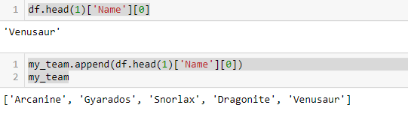


Slide 24


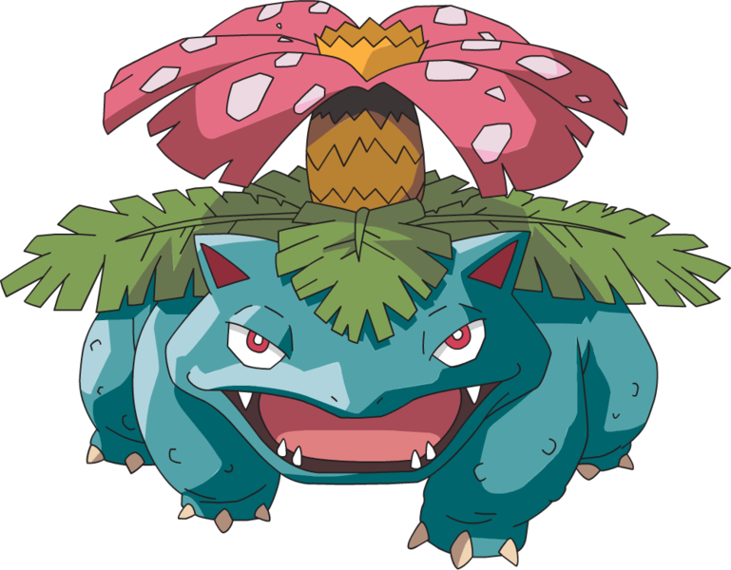
How to get Venusaur in the game
At the beginning of the game, you'll be given a choice of three starter Pokémon by Professor Oak: Bulbasaur, Charmander, and Squirtle. Choose Bulbasaur as your starter.
You'll need to level up your Bulbasaur to evolve into Ivysaur at level 16, continue leveling up your Ivysaur, and it will evolve into Venusaur at level 32.
Once you have Venusaur, it will be a powerful Pokémon and a valuable member of your team.
Venusaur has access to a variety of moves and can be a strong addition to your roster throughout your journey.

Slide 25
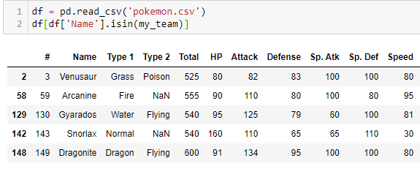
Then we drop all Pokémons with the same types we have

Slide 26
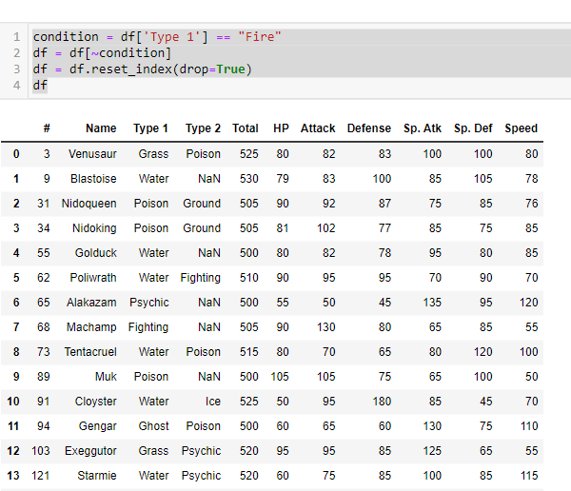


Slide 27
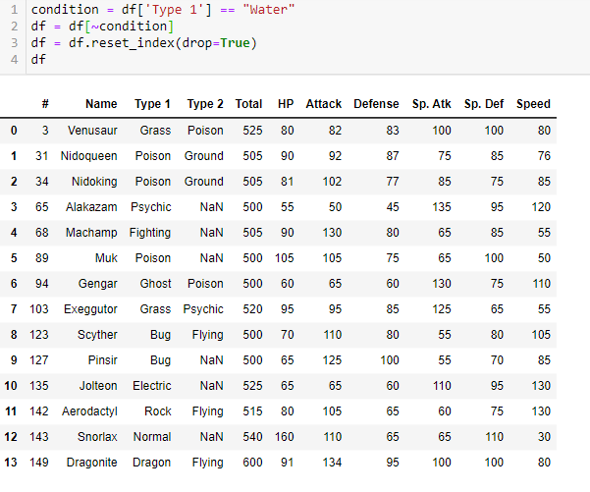
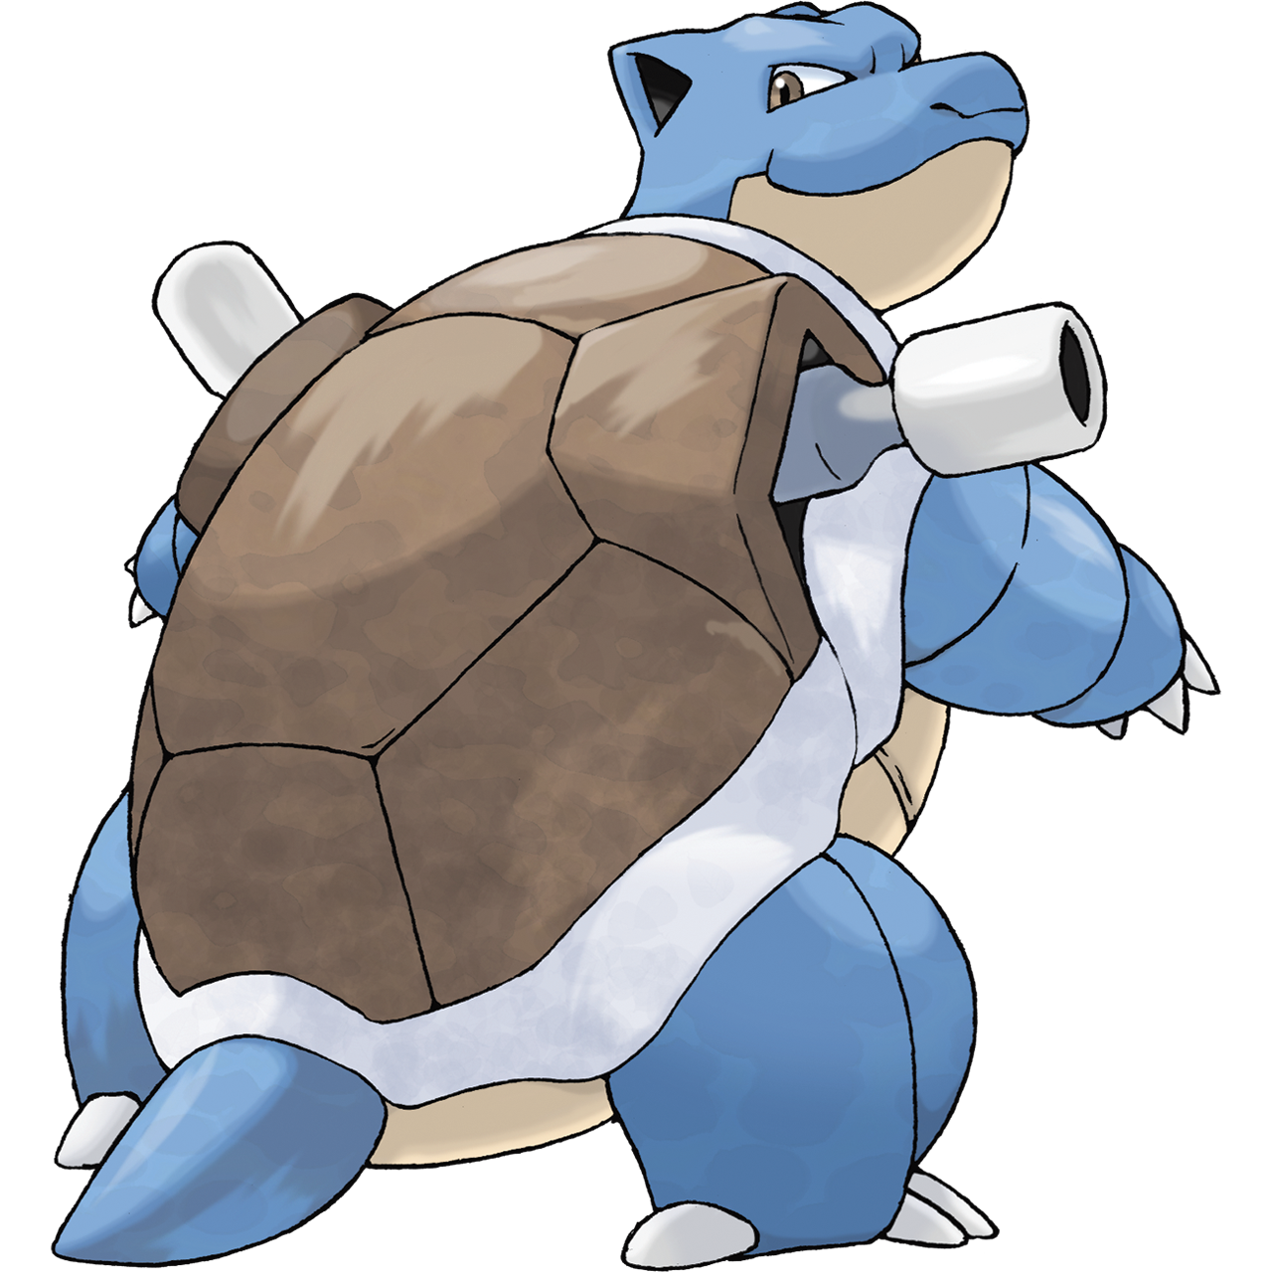

Slide 28
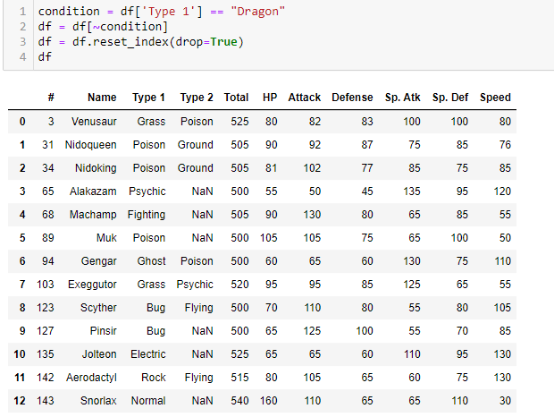
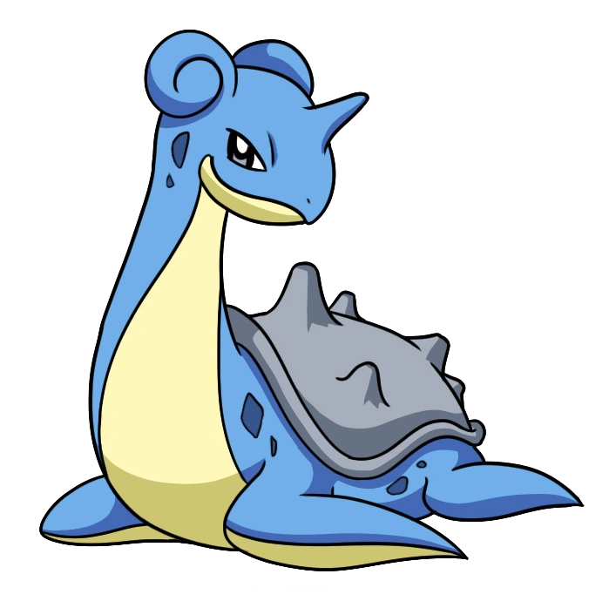

Slide 29

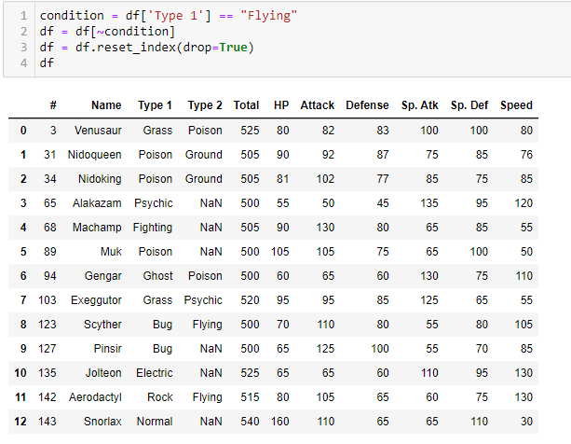

Slide 30
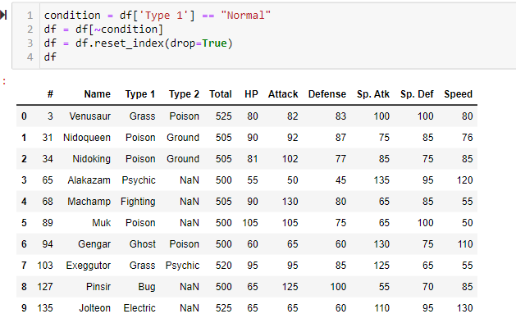


Slide 31
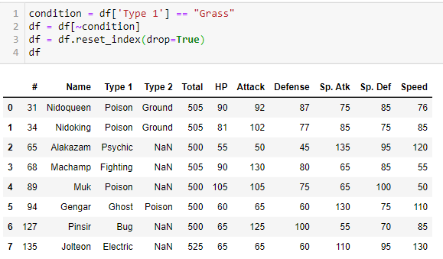


Slide 32
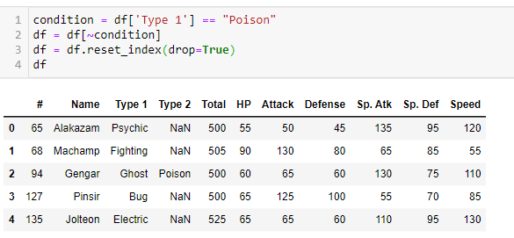


Slide 33

I did the same thing for the second type by removing the same types also

Slide 34
Now we need a fast guy to the squad

Slide 35
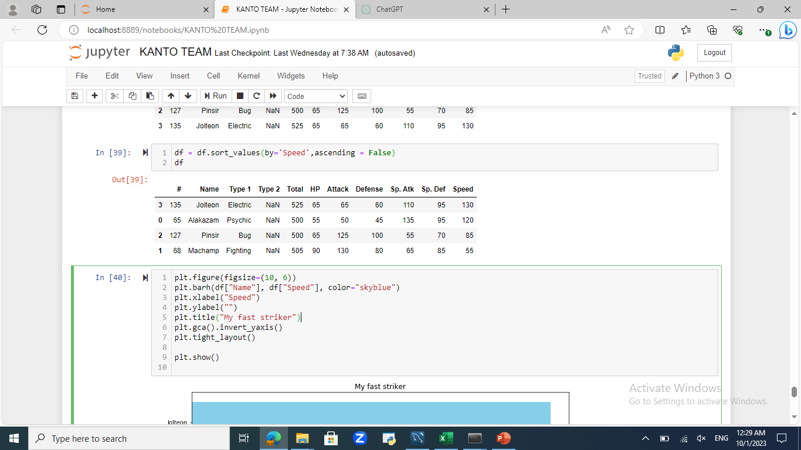
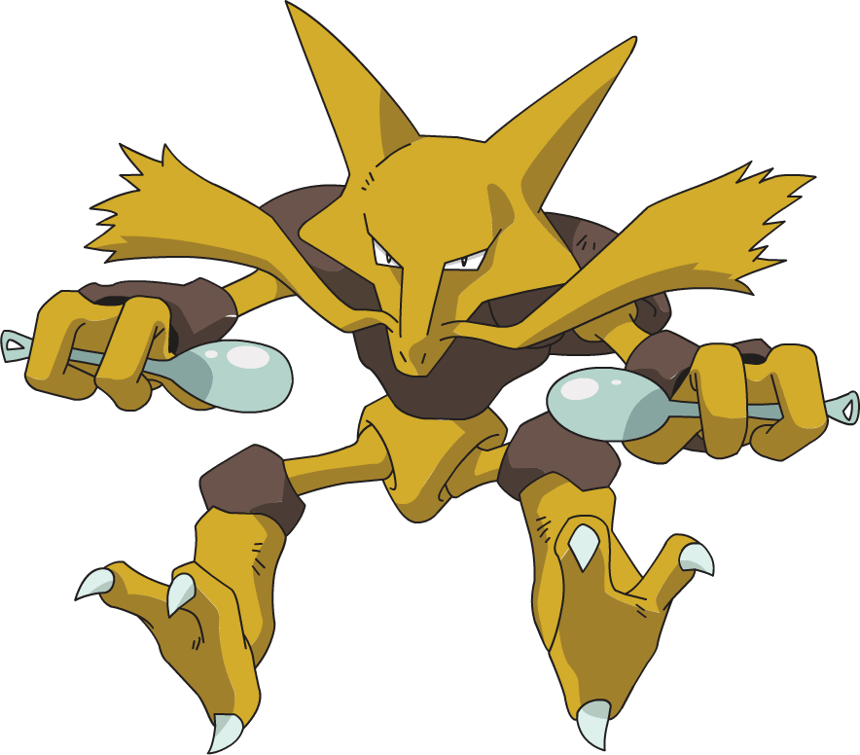
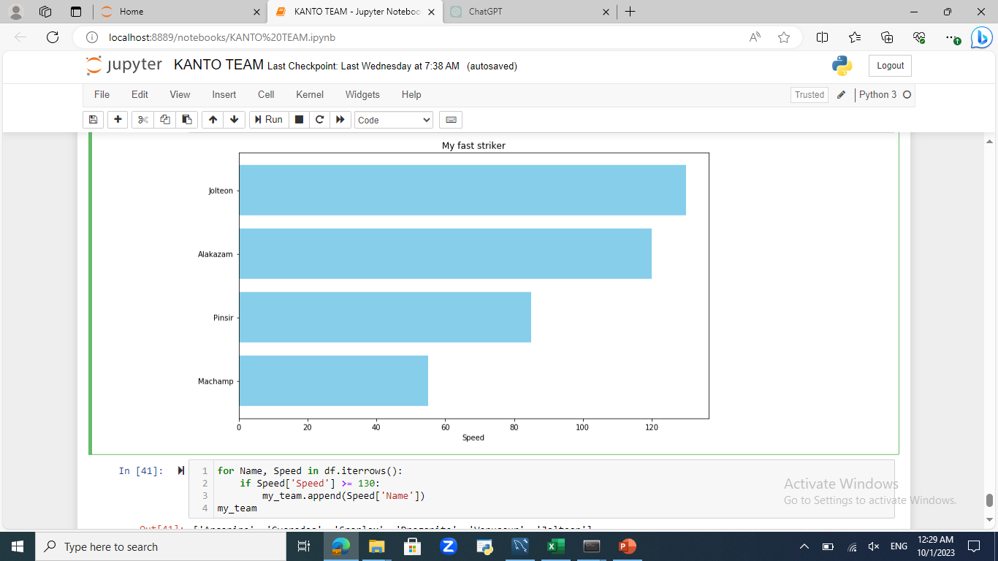

Slide 36



How to get Jolteon in the game
The first step to getting a Jolteon is to acquire an Eevee, you can find an Eevee on the rooftop of Celadon Mansion in Celadon City.
To reach the rooftop, you need to access the back entrance of the Celadon Mansion, which is the building located in the northern part of the city, after obtaining an Eevee, it will be at level 25.
Eevee evolves into Jolteon through the use of a Thunder Stone simply use a Thunder Stone on your Eevee, and it will instantly evolve into Jolteon.
you'll have a Jolteon, a fast and powerful Electric-type Pokémon, Jolteon has a range of Electric-type moves and can be a valuable member of your team.

Slide 37
Let’s take a final look to the team now

Slide 38
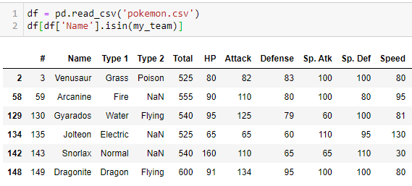

Slide 39
You wanna play the game now just follow this
You first need a GBA emulator and you can download it from here : bit.ly/3FpVsx9
Then you gotta download the game and you can download it from here : bit.ly/3Q5505u
Now just open the emulator and choose the game and enjoy playing one of the best games of all time.
THANKS FOR YOUR TIME <3

